Slide 1
EWP

Slide 2
Sprint 5 ADDitions
Account Details Now Editable
View All Transactions
View Transactions for Single Account
Delete Transactions
Enter New Codes
Date is Editable
Mac/PC slight variations
Cosmetic Changes
Benefits Calculator?
User Guide?

Slide 3
Comments
Needs Work:
Back Button
Confusion with Phrasing
Rounded Decimals
Good:
Aesthetics/Cosmetic things
Mutability
Flow
View Transaction History

Slide 4
MVC
Engorged Wicket Pandoras

Slide 5
CONTROLLER
DIAGRAM
MODEL
VIEW

Slide 6
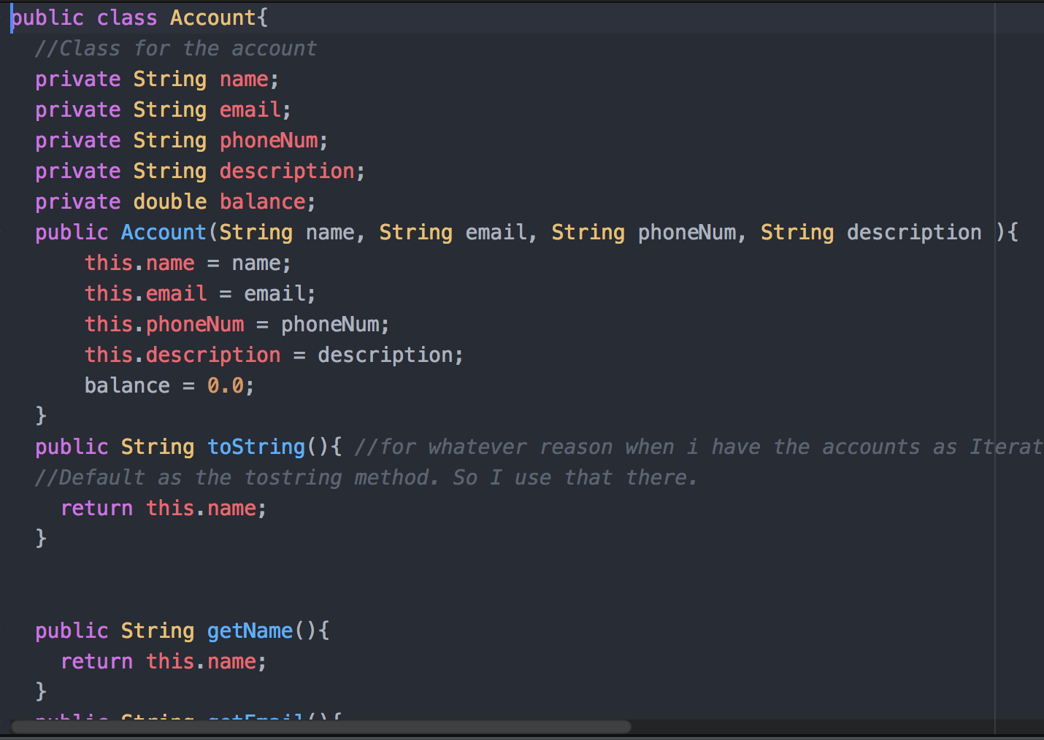
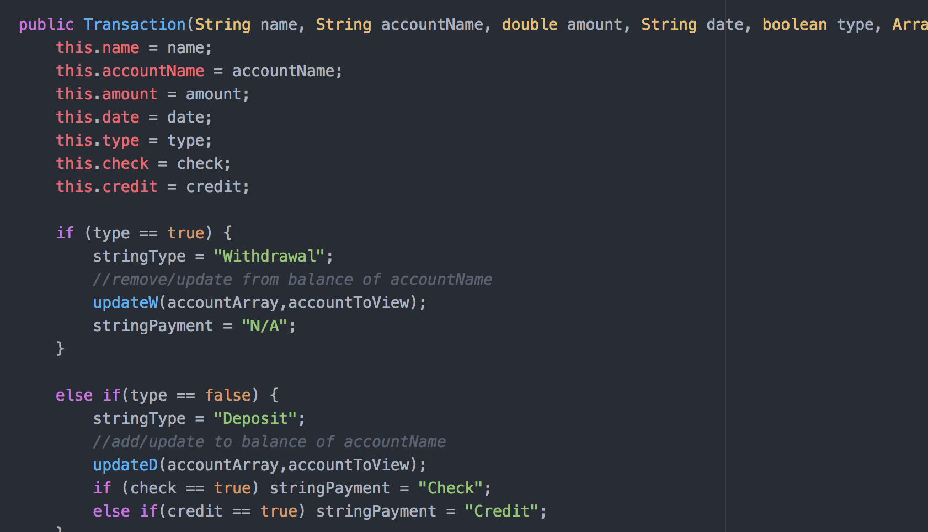
MODEL
MAIN CLASSES
Account
Transaction
Withdrawal
Deposit
Save File
Transaction File

Slide 7
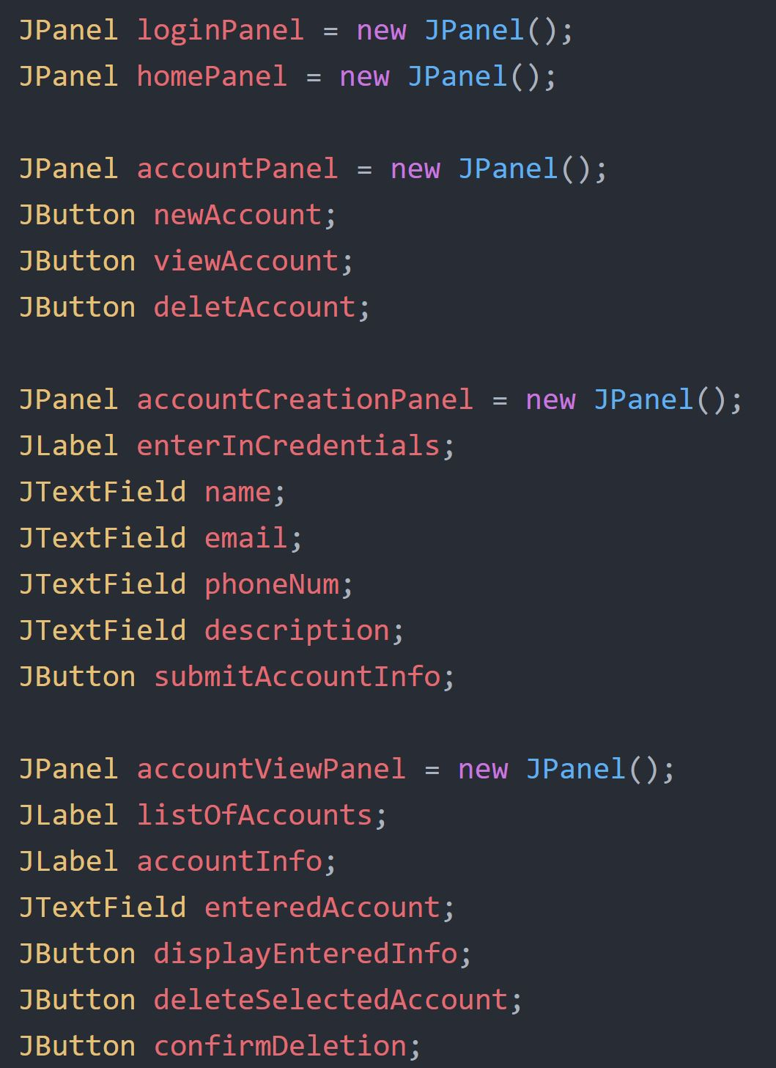
VIEW
CODE EXAMPLE:
MAIN FRAME
PANELS
LogInPanel
HomePanel
AccountPanel
Etc.
PANEL CONTENT
Jlabels, Dropdown Lists
JButtons
JTextFields, JPasswordFields
Logo!
Executable .jar file

Slide 8
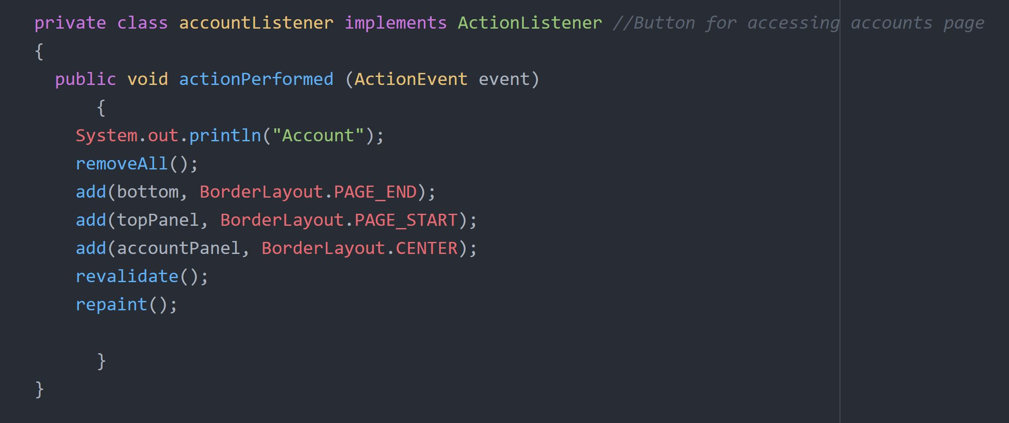
Controller
CODE EXAMPLES:
LISTENERS
ActionListeners for all JButtons:
Home
Logout
Account, create account, delete account
New Transactions
Click to delete textfields

